Slide 1


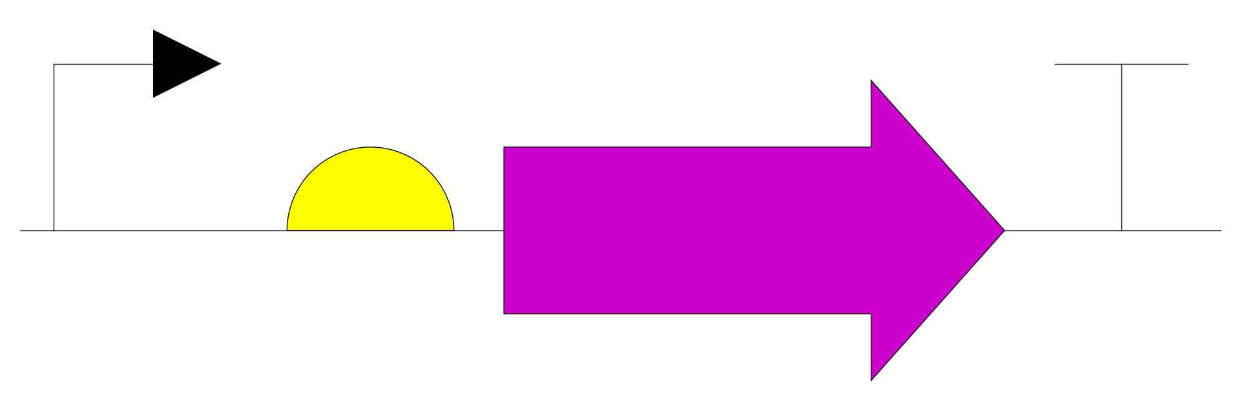
X-gal
BioPAX: SmallMolecule
[H][C@]1(O[C@H](CO)
\
SBO: degradation
O
SBO: activator
SBO: activator
miRNA-X
BioPAX: RNA
SO: miRNA
SO: reading_frame
SO: miRNA_target
SBO: modifier
lacZ
BioPAX: RNA
SO: transcript
LacZ
BioPAX: Protein
lacZ
BioPAX: DNA
SO: coding_sequence

